Slide 1

MotoWeather Maps
AI-Powered Route Planning & Weather Analysis for Motorcyclists
Presented by: Pratik Naik | Context: Web Application Development / Full Stack Project

Slide 2

The Perilous Ride: Weather's Impact on Motorcyclists
Heightened Vulnerability
Inadequate Information
Packing Dilemmas
Motorcyclists face significantly greater risks from adverse weather conditions compared to car drivers.
Most weather applications provide only destination weather, neglecting critical conditions along the entire route.
Riders struggle to anticipate and pack appropriate gear for long journeys with unpredictable elevation and climate shifts.
A crucial need exists for a specialized tool that offers granular weather insights and safety guidance for every mile of the ride.

Slide 3
MotoWeather Maps: Your Intelligent Co-Pilot
MotoWeather Maps is a sophisticated web-based dashboard designed to transform motorcycle trip planning and safety.
Dynamic Route Calculation
Precision Weather Overlay
Calculates optimal driving routes between user-defined cities.
Integrates real-time weather data at precise 35km intervals directly onto your planned path.
AI-Powered Insights
Cloud-Based Management
Leverages Generative AI to deliver critical safety summaries and personalized gear packing lists.
Enables seamless saving and retrieval of routes via secure cloud storage.

Slide 4



Powering the Journey: Our Robust Tech Stack
Frontend Excellence
Reliable Backend & Services
Intelligent External APIs
HTML5 & Tailwind CSS: For a responsive, sleek dark-mode user interface.
OpenRouteService: For accurate geocoding and dynamic driving directions.
Firebase (Firestore & Auth): Provides a real-time database and secure anonymous authentication for user data.
Leaflet.js: Powers interactive mapping and data visualization.
OpenWeatherMap: Delivers current weather data for specific coordinates.
Turf.js: Essential for geospatial analysis and precise path segmentation.
Google Gemini AI: The engine behind intelligent trip analysis and recommendations.

Slide 5
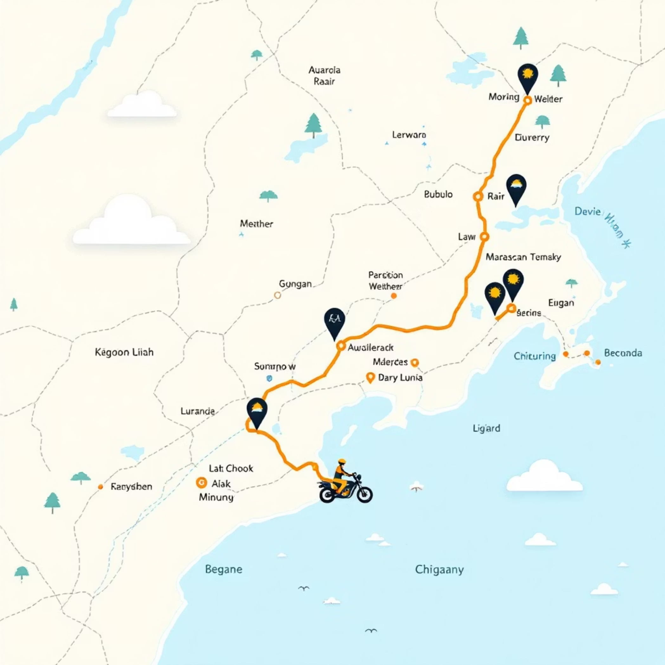
Intelligent Routing: Mapping Your Adventure
Seamless Path Generation
User Input: Riders simply enter their desired start and end locations.
Geocoding Precision: Converts city names into precise Latitude/Longitude coordinates using OpenStreetMap/Nominatim.
Optimal Pathfinding: Fetches the most efficient driving geometry from OpenRouteService.
Visual Route Display: The route polyline is vividly rendered on a dark-themed Leaflet map, enhanced with a real-time rain radar overlay.

Slide 6

Revolutionary Weather Sampling Algorithm
Moving beyond conventional apps, MotoWeather Maps samples conditions along the entire route, not just the destination.
01
02
Route Segmentation
Interval Weather Fetch
The calculated route line is intelligently divided into 35km segments utilizing Turf.js for accuracy.
Precise weather data is retrieved for each individual segment, ensuring comprehensive coverage.
03
Smart Filtering for Clarity
To prevent map clutter, weather markers are only displayed for significant changes: temperature shifts (>3°C), condition changes (e.g., Sun to Rain), or at predetermined fixed intervals.

Slide 7


AI Integration: Personalized Safety & Gear Advice
Powered by Google Gemini AI, MotoWeather Maps transforms raw data into actionable intelligence.
"Ride Insight"
"Gear Check"
The app constructs a detailed prompt with weather samples and route data, generating a concise difficulty summary and a valuable pro safety tip tailored to your journey.
Based on the specific weather conditions encountered along the route, Gemini AI produces a precise, bulleted checklist of recommended motorcycle gear. Examples include: "Pack rain gear for afternoon showers," or "Consider a mesh jacket for warmer segments."

Slide 8

Cloud Persistence: Your Routes, Always Accessible
Leveraging Firebase for robust and real-time data management.
1
2
Secure Route Saving
Real-time Updates
All planned routes are securely saved to Firestore within a user-specific collection, ensuring your data is always private and organized.
The "Saved Routes" list benefits from real-time listeners, meaning any additions or deletions update instantly on your dashboard without needing to refresh the page (utilizing onSnapshot functionality).
3
Seamless Anonymous Authentication
Anonymous Authentication allows users to begin using the app immediately without the friction of complex sign-up flows, enhancing user experience from the first click.

Slide 9



Overcoming Obstacles: Challenges & Solutions
API Key Security
Ensuring the security of sensitive API keys was paramount. Our solution eliminates hardcoding by implementing a Settings UI, allowing users to dynamically input their own keys, maintaining privacy and flexibility.
Map Clutter
Displaying too many weather markers could overwhelm the map. We addressed this by integrating sophisticated logic that filters weather markers, only showing them when conditions significantly change, maintaining visual clarity.

Slide 10

The Road Ahead: Future Improvements
Our vision for MotoWeather Maps extends beyond current capabilities, with exciting enhancements planned.
Turn-by-Turn Navigation
Enhanced User Profiles
GPX Export Functionality
Upgrading from anonymous authentication to full Google/Email login options, enabling cross-device syncing and personalized preferences.
Integrating live voice guidance to enhance the riding experience and reduce the need for screen interaction.
Allowing users to export their planned routes in GPX format, providing compatibility with external GPS devices for seamless navigation.

